Slide 1
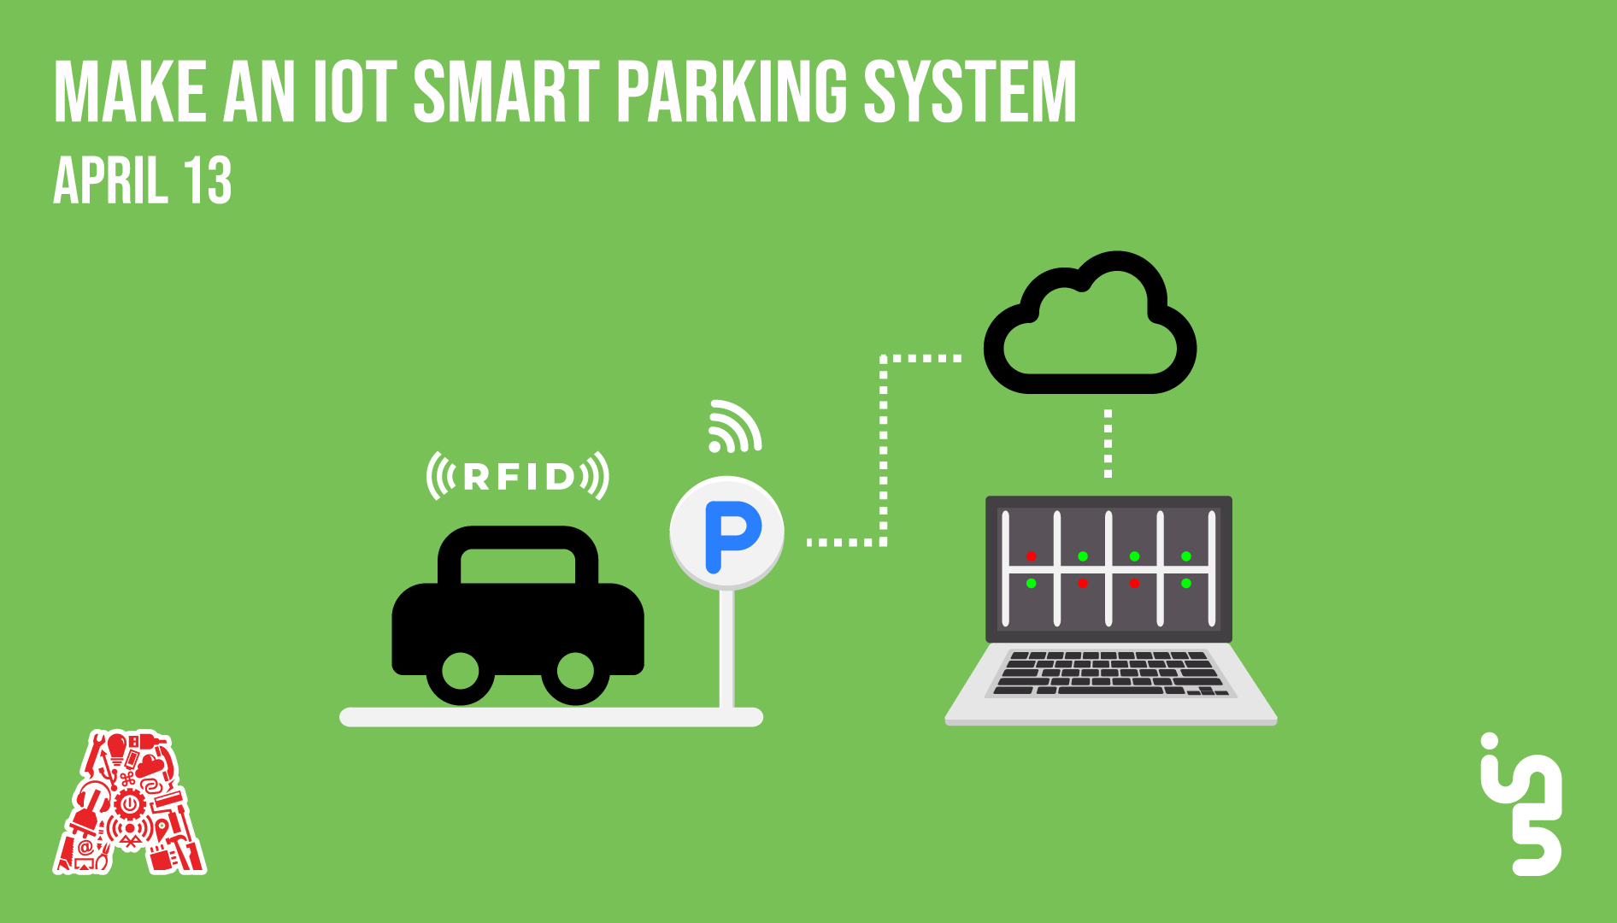

Slide 2
About the Assembly
A smart lab based out of In5 since Dec 2014
Over 200 free workshops done
ASSEMBLY: HACK - Embedded systems, iOT and hardware
ASSEMBLY: CODE - Software projects - APIs, frameworks, apps
Age range: 16-60 - students, professionals, entrepreneurs
Focus on smart technology and practical applications
Forum: members.theassembly.ae

Slide 3
TAG US ON OUR SOCIAL MEDIA
FACEBOOK
TWITTER
INSTAGRAM
YOUTUBE
The Assembly (@MakeSmartThings)
@MakeSmartThings
@MakeSmartThings
The Assembly

Slide 4
Agenda
Why a smart parking system?
Architecture of our solution
Node-Red
Sensor Implementation (Ultrasonic)
RFID Implementation
Firebase
MIT app Inventor
User Interface Implementation

Slide 5
Why a smart parking system?
Moving forward in technology
Tracking and using data
Better living standards
Can be made to supplement a service
Improving security systems

Slide 6
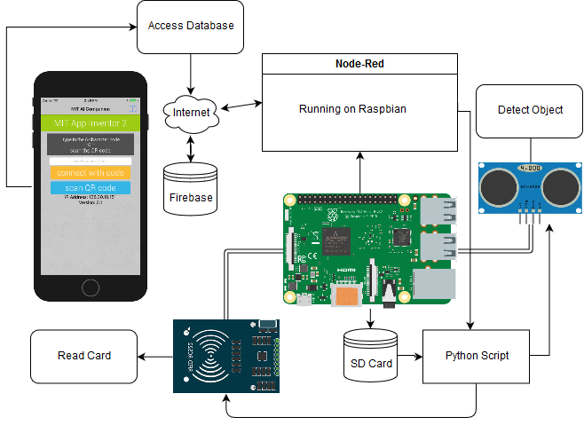
Architecture
Raspberry Pi
Node-Red
Google’s Firebase
MIT App Inventor

Slide 7
Github link
https://github.com/The-Assembly/Smart_Parking

Slide 8
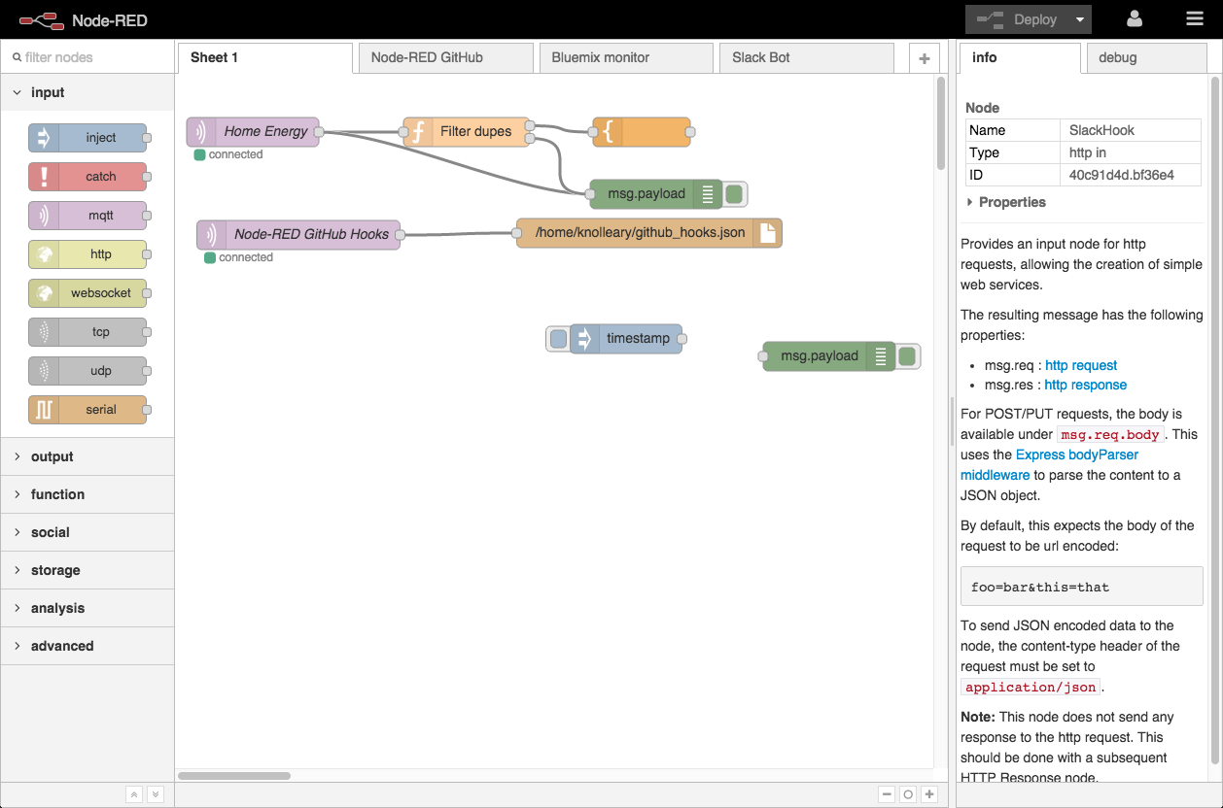

Node-Red
Flow-based visual programming tool
Used for wiring in IoT projects
Developed by IBM

Slide 9
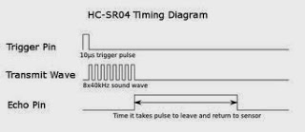
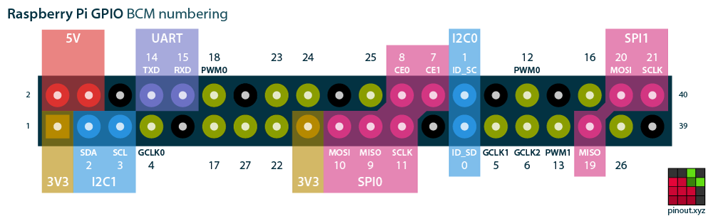
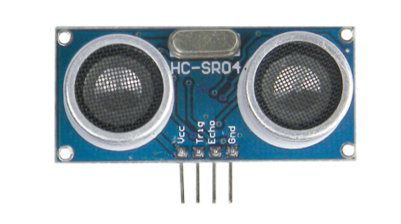
Sensor Implementation
Accurate within 30 degrees
VCC on 5V, Echo on 3.3V
Trigger pulse lasts 10 microseconds
Green Pins for Trigger/Echo
Red for 5V, Black for GND
Predefined: 5,6,12,13,16

Slide 10
Sensor Implementation
Connect the ultrasonic sensor according to circuit diagram.

Slide 11
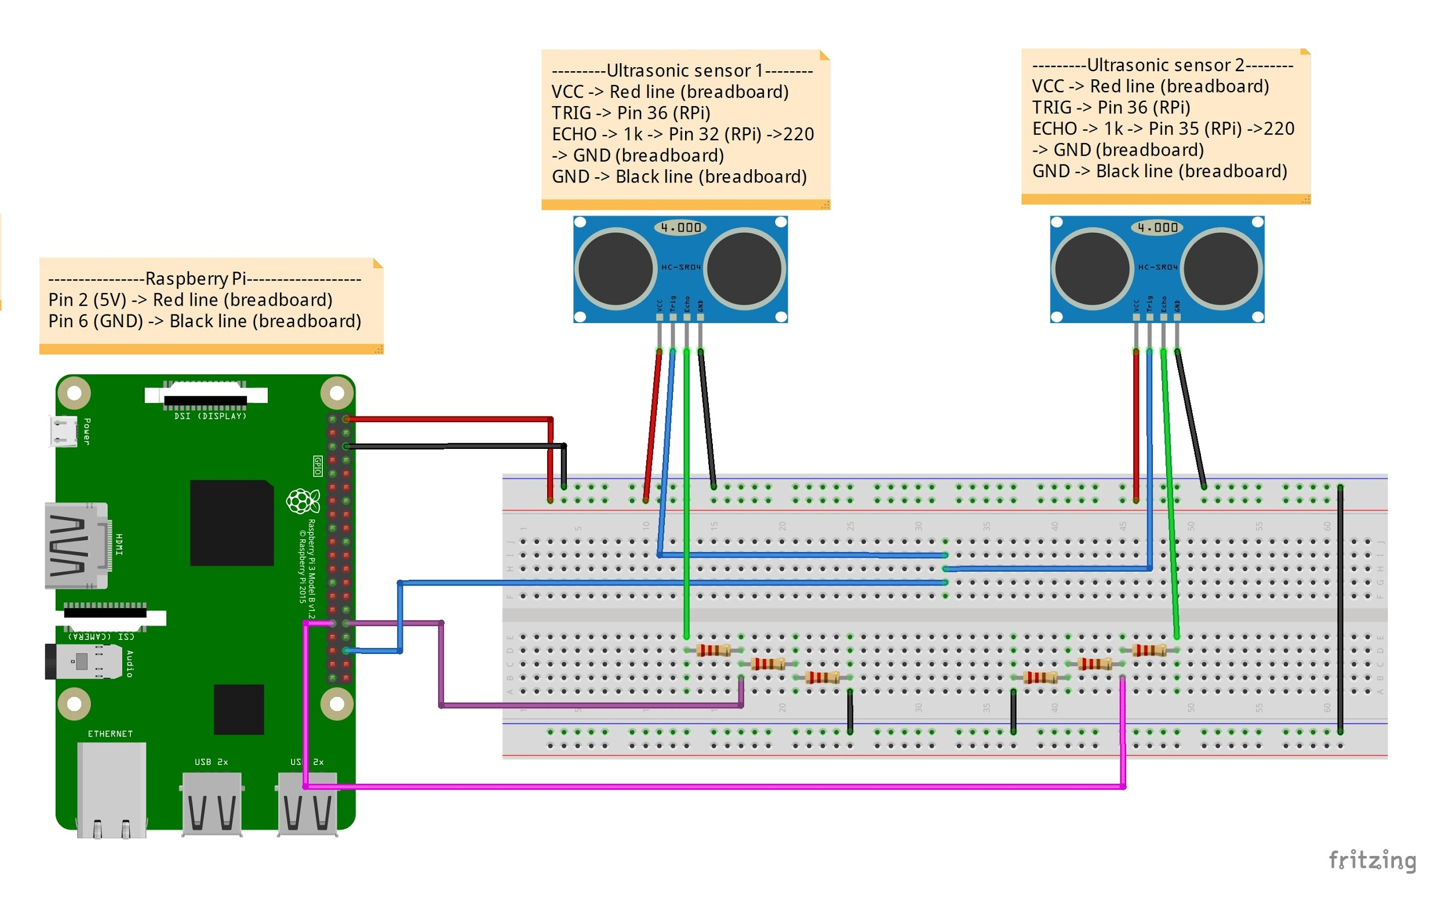

Slide 12
Sensor Implementation
Install the file “ultrasonic.py” from the assembly repository

Slide 13
Sensor Implementation
Access Node-red
Start Node Red: Run the command:
node-red-start
Access URL from your web browser: http://<iprasberrypi>:1880. For example my Pi is on my home office network on address 192.168.1.8, so to access Node-RED I browse to http://192.168.1.8:1880/

Slide 14

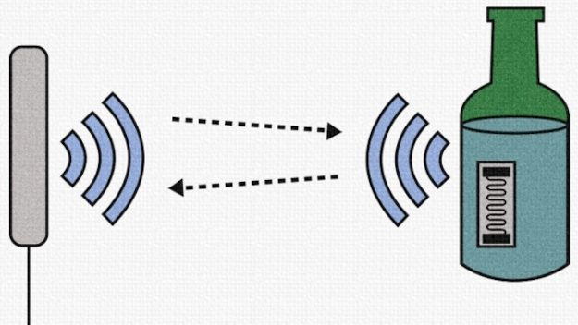
Radio Frequency Identification
Notes:
https://www.abr.com/what-is-rfid-how-does-rfid-work/

Slide 15
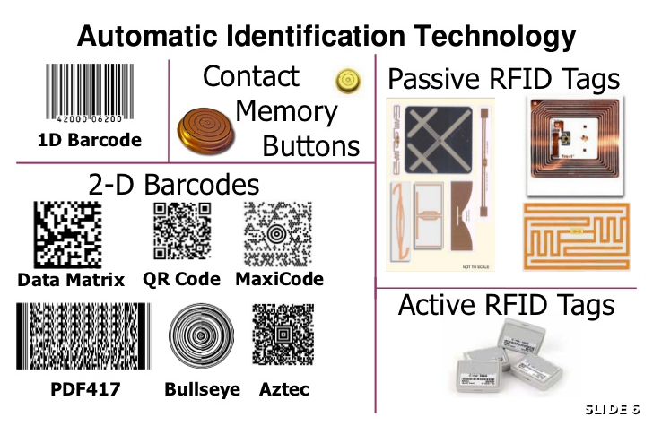
Notes:
https://blog.atlasrfidstore.com/active-rfid-vs-passive-rfid

Slide 16
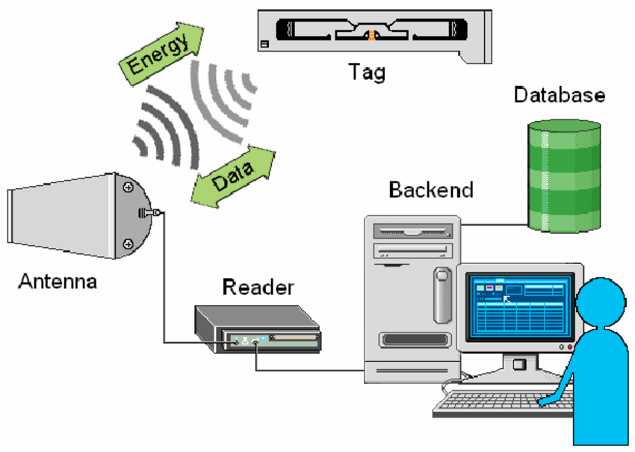

Slide 17
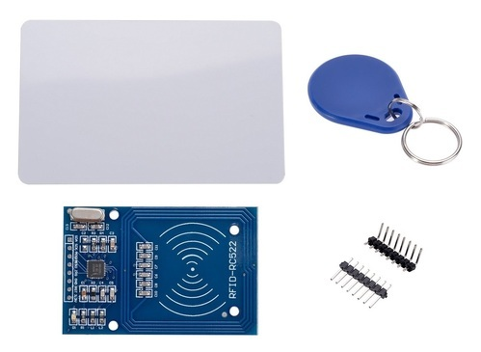
RC522
Supports all variants of MIFRARE tags
Highly integrated reader/writer IC for contactless radio communication
Operation range at 13.56 MHz
Operating distance up to 50 mm depending on the antenna size and tuning
Notes:
https://www.nxp.com/docs/en/data-sheet/MFRC522.pdf

Slide 18
RFID Implementation
Step One
Connect the RC522 card reader to your Pi 3

Slide 19
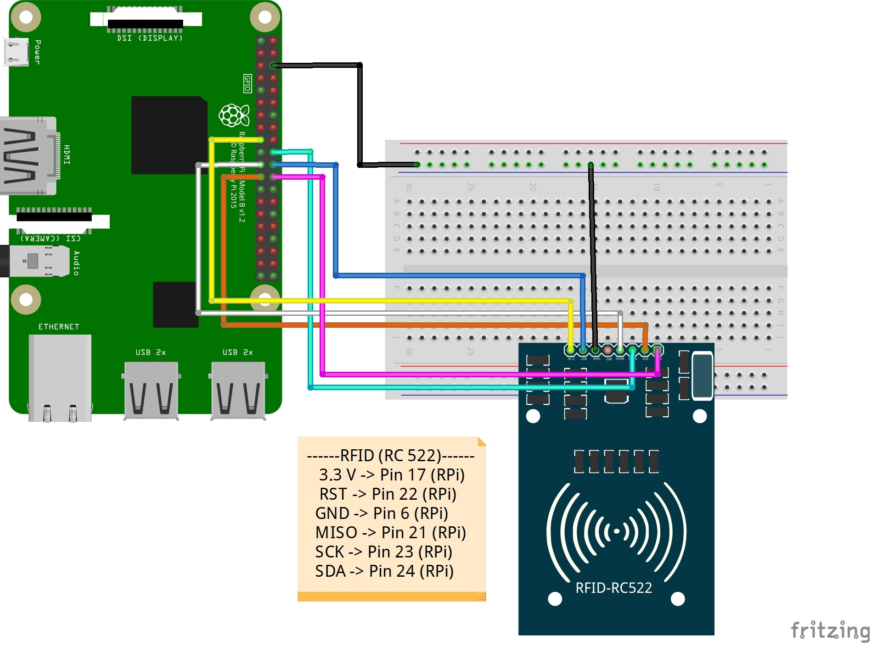

Slide 20
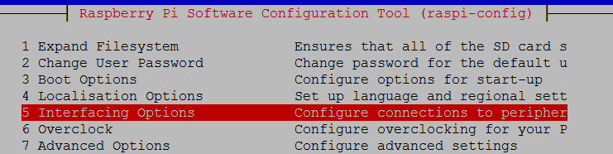
RFID Implementation
Step Two
At command prompt type
sudo raspi-config
Highlight 5 Interfacing Options and press Enter:

Slide 21
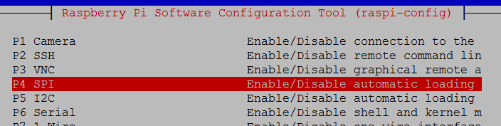
RFID Implementation
Step Two
Highlight P4 SPI and press Enter:
Select Yes and press Enter, then on OK press Enter, press tab twice to select Finish and press Enter to exit the configuration utility.

Slide 22
RFID Implementation
Step Four
Install the file “rfidreader.py” from the assembly repository

Slide 23
RFID Implementation
Step Five
Move to Node red

Slide 24

Firebase
Development platform for mobile and web applications
Developed by Firebase Inc., now
acquired by Google.
Provides a real-time database and
backend as a service.
https://firebase.google.com/

Slide 25

MIT App Inventor
An open source web application provided by Google now maintained by MIT
Allows users to drag-and-drop visual
objects to create software application
for android devices.
http://appinventor.mit.edu/explore/

Slide 26
Thank You

